Slide 1
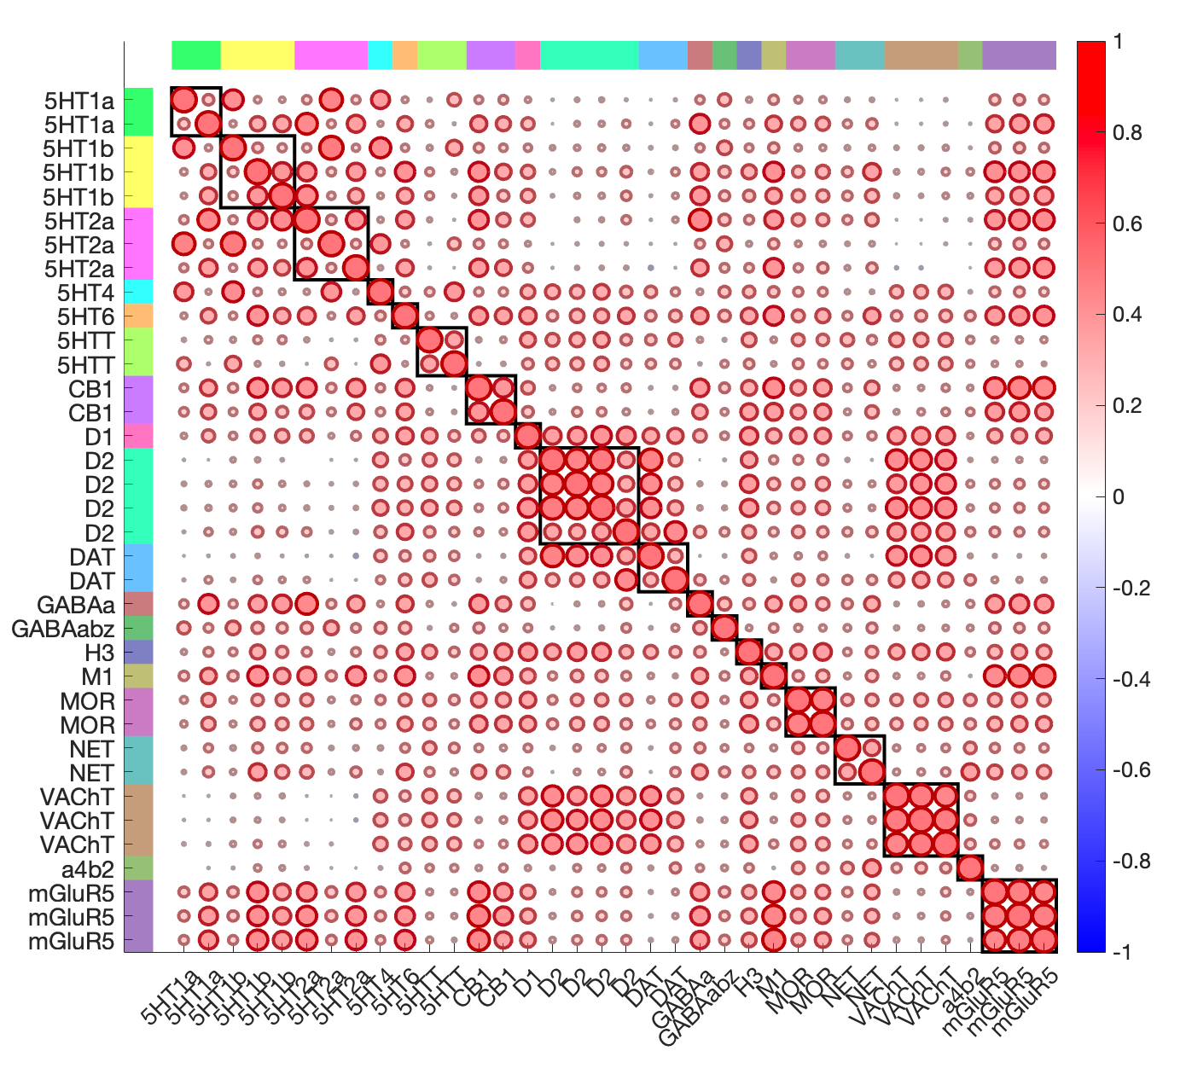
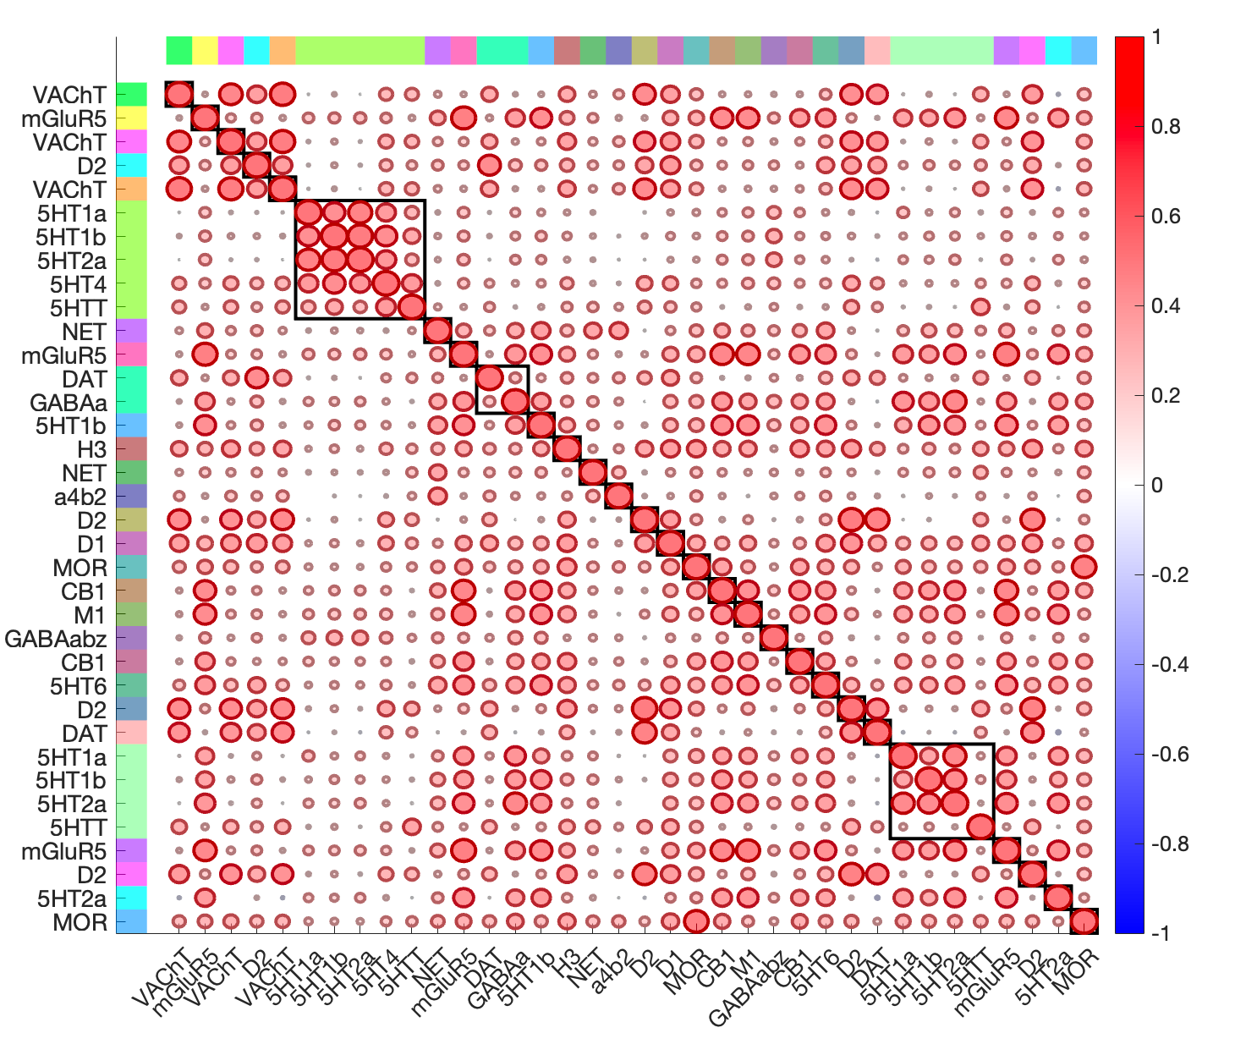
Before cleanup
Some low correlations between maps of the same transmitter
Maps from the same study corelate highly, even across transmitters
Higher correlations with maps of diff vs. same transmitter
Colored bars and order = same transmitter
Colored bars and order = same study
See canlab_explore_neuromaps_pet_images.mlx

Slide 2
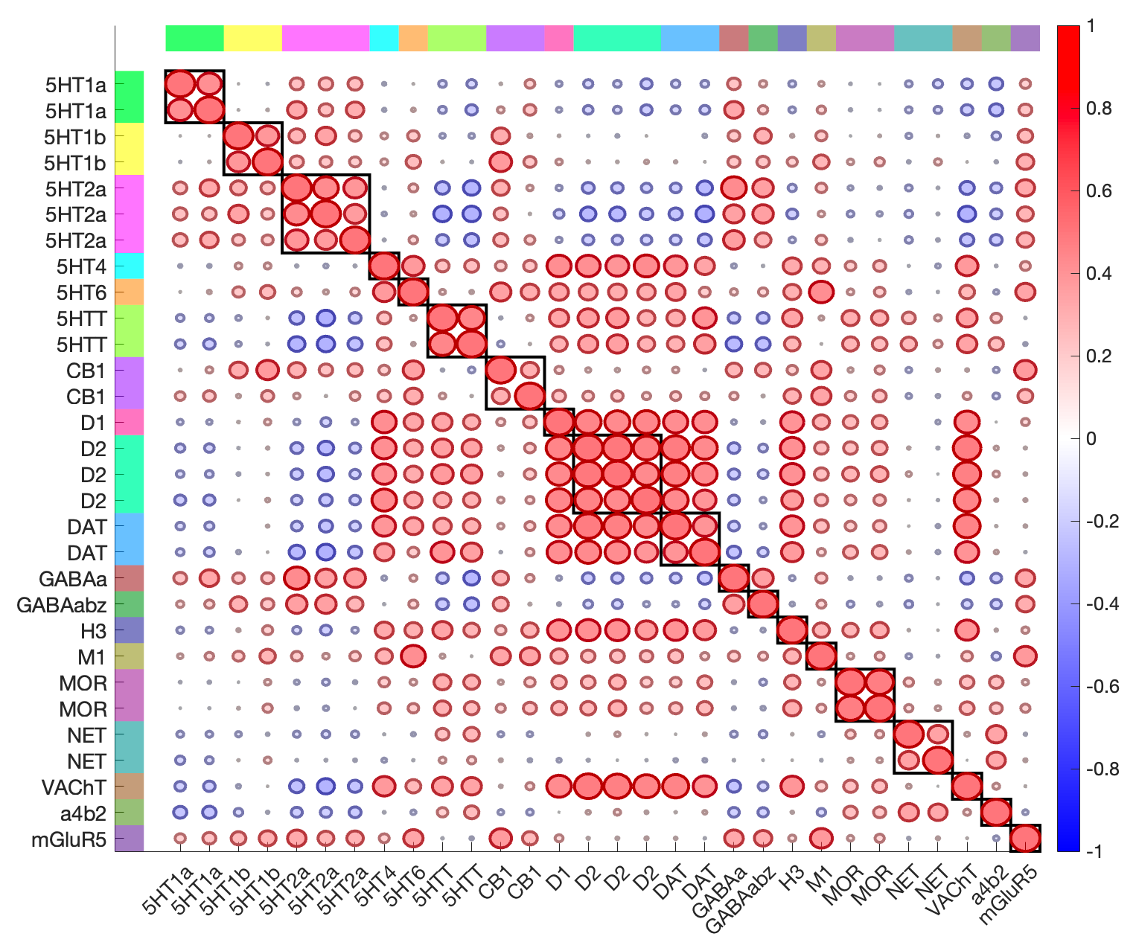
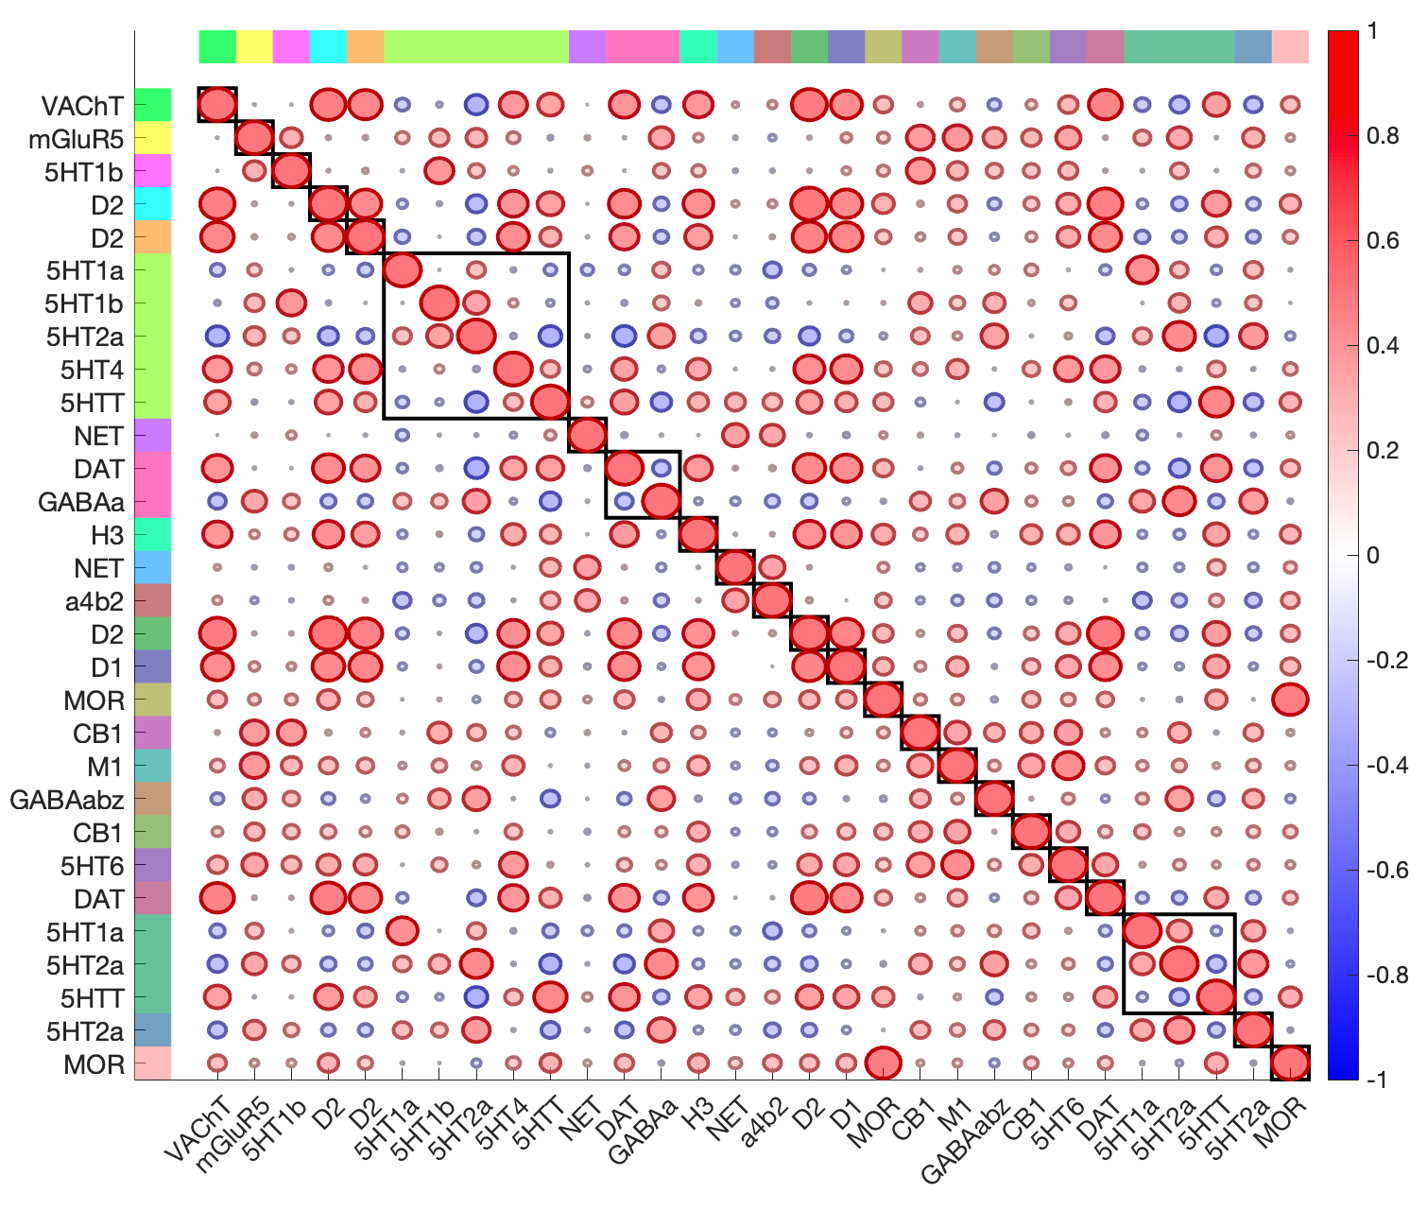
After cleanup
Strongest correlations are more often within transmitter type
Maps from the same study but diff transmitters show lower intercorrelations
Colored bars and order = same transmitter
Colored bars and order = same study
See canlab_explore_neuromaps_pet_images.mlx

Slide 3
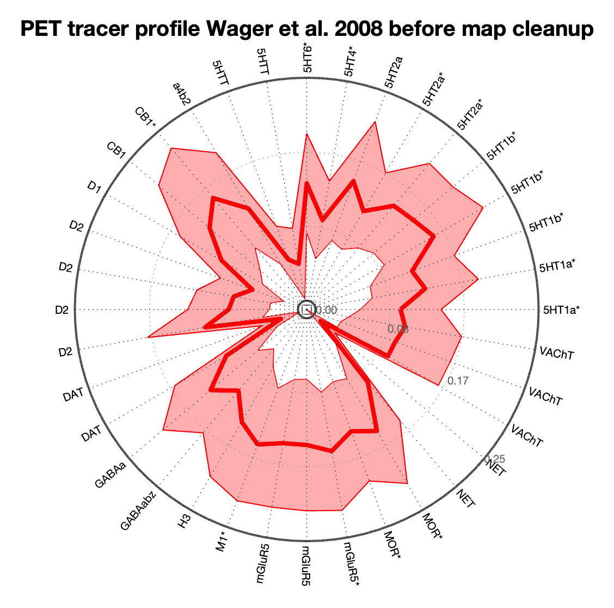
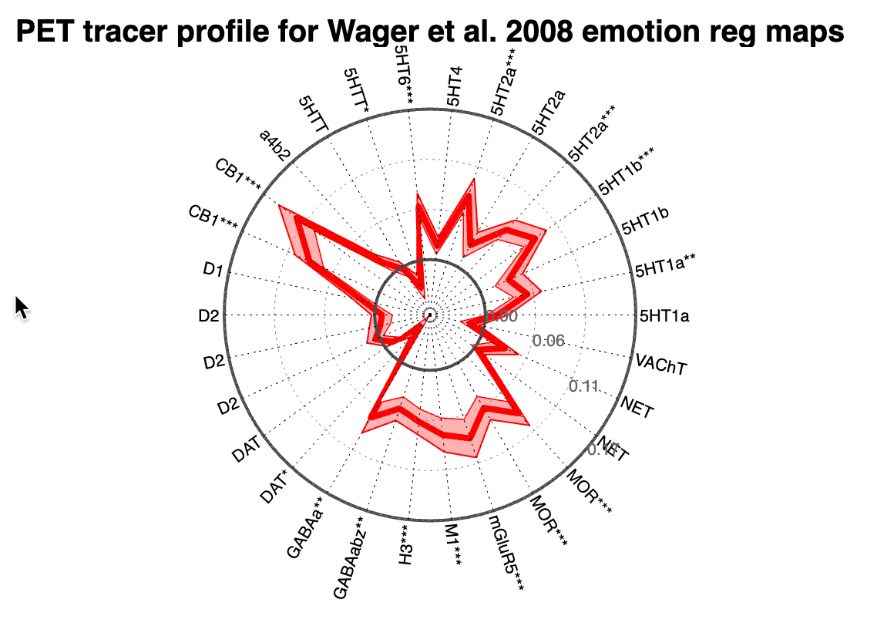
Comparison of PET neuromap profiles before and after cleanup
Shaded regions are SEM across individual subjects
From Wager et al. 2008, Neuron, n = 30

Slide 4
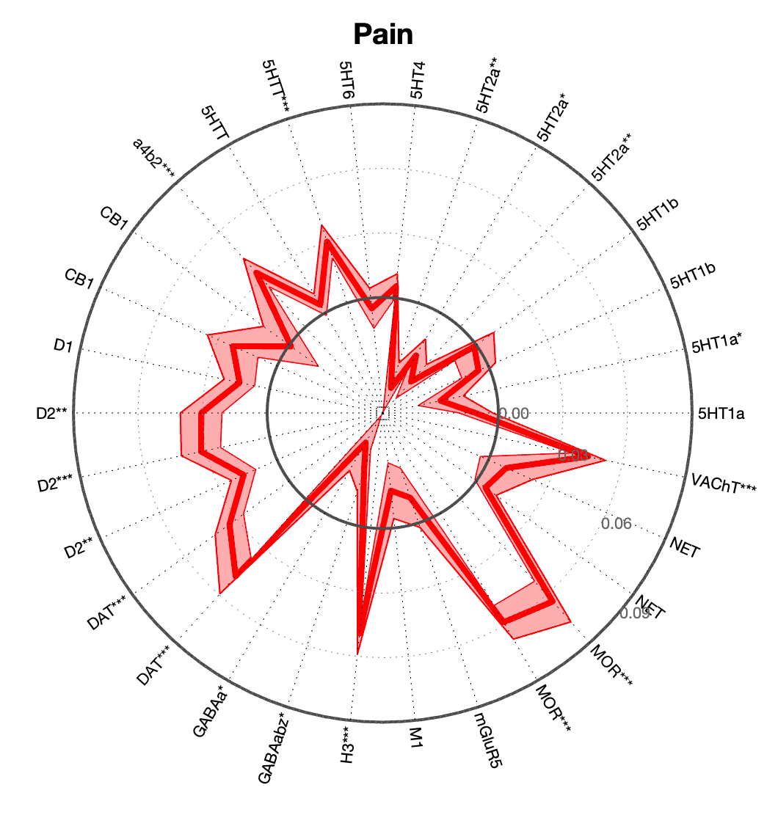
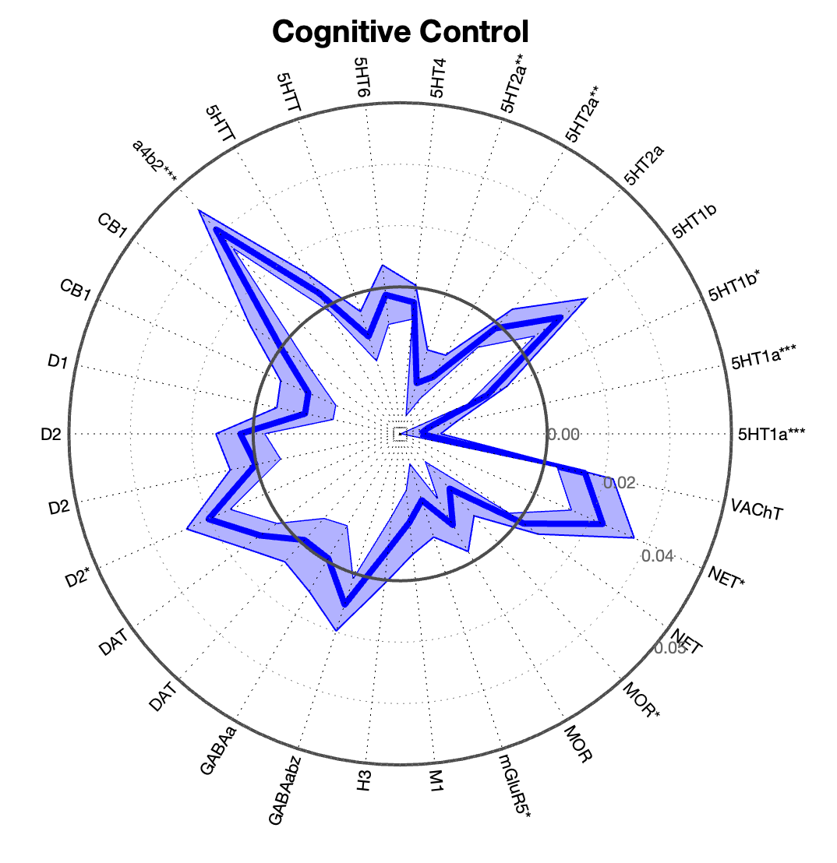
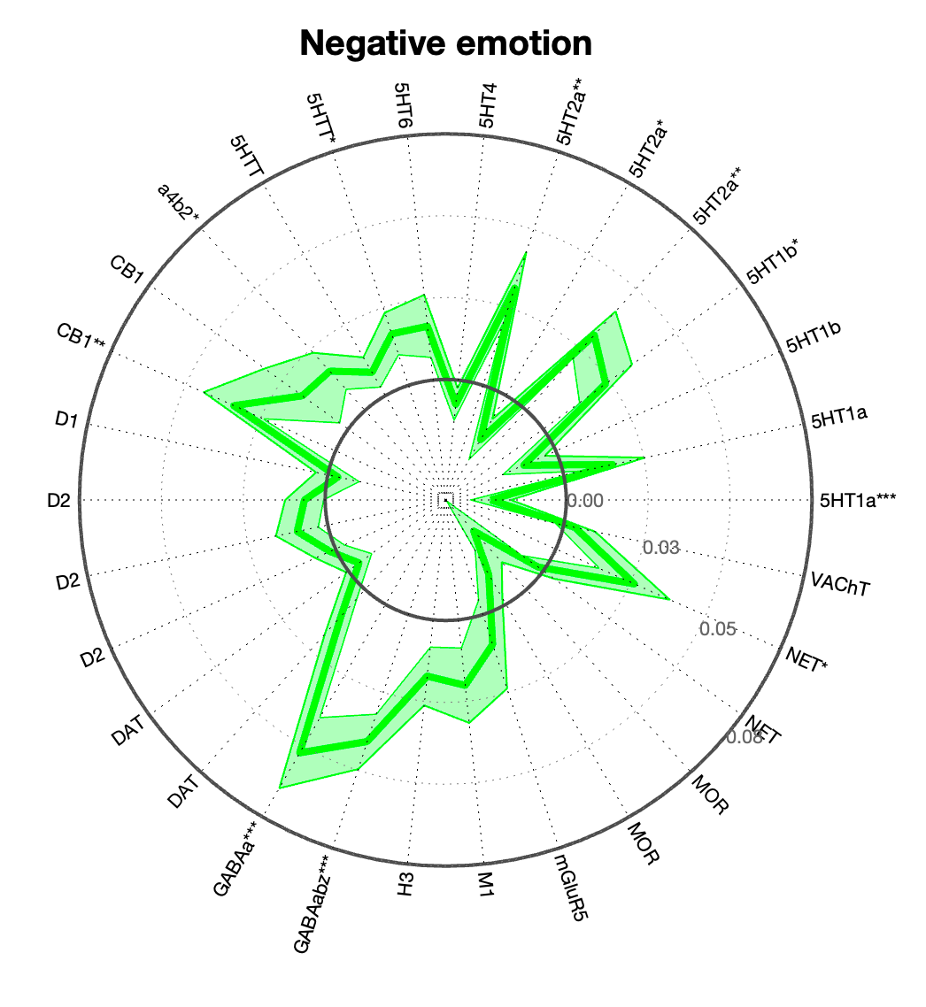
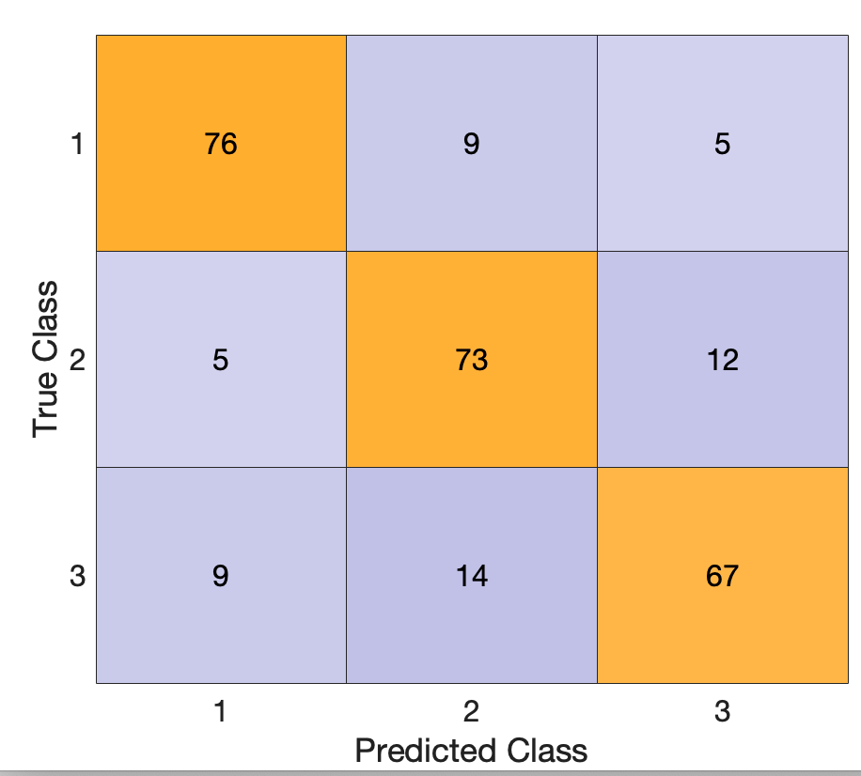
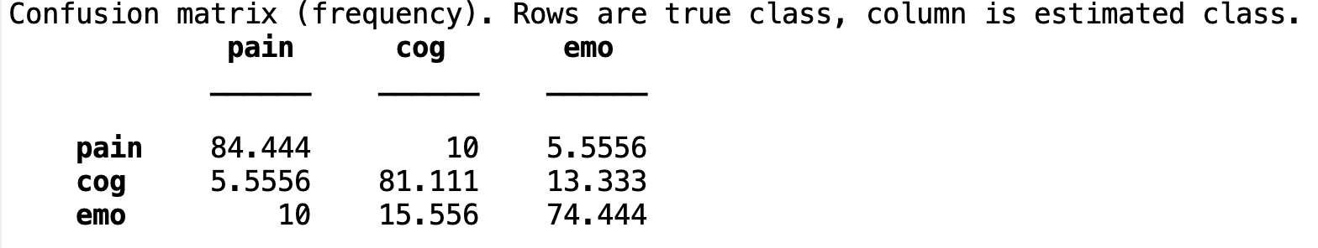
Classification with neurotransmitter map embedding in Kragel280 dataset (from Kragel 2018 Nat Neuro)

